Slide 1
Access Control
Corporate Computer Security, 4th Edition
Randall J. Boyle & Raymond R. Panko
Chapter 5

Slide 2
Orientation
If attackers cannot get access to your resources, they cannot attack them
This chapter presents a number of important access control tools, such as reusable passwords and biometrics
We covered cryptography before access controls because many access controls use cryptography

Slide 3
5.1: Access Control
Access Controls (AC)
  Limit access to physical & electronic resources
  Policy-driven control of access to systems, data..
  Often use cryptography as part of what they do and how they work

Slide 4
5.1: Access Control
The AAA Protections
  Authentication —supplicant sends credentials to verifier to authenticate the supplicant
  Authorization —what permissions the authenticated user will have
    What resources he or she can get to at all
    What he or she can do with these resources
  Auditing —recording what people do in log files
    Detecting attacks
    Identifying breakdowns in implementation

Slide 5
5.1: Access Control
Credentials Are Based On
  What you know (e.g., a password)
  What you have (e.g., an access card)
  What you are (e.g., your fingerprint) or
  What you do (isn’t it already covered?) (e.g., speaking a passphrase)
  Your location (e.g. your IP)

Slide 6
5.1: Access Control
Two-Factor Authentication
  Use two forms of authentication for defense in depth
  Example: access card and personal identification number (PIN)
  Multifactor authentication: two or more types of authentication
  Can be defeated by a Trojan horse on the user’s PC
  Can also be defeated by a man-in-the-middle attack by a fake website

Slide 7
5.1: Access Control
Individual and Role-Based Access Control
  Individual access control: bases access rules on individual accounts
  Role-based access control (RBAC)
    Bases access rules on organizational roles (e.g., buyer, member of a team, etc.)
    Assigns individual accounts to roles to give them access to each role’s resources
    Cheaper and less error-prone than basing access rules on individual accounts

Slide 8
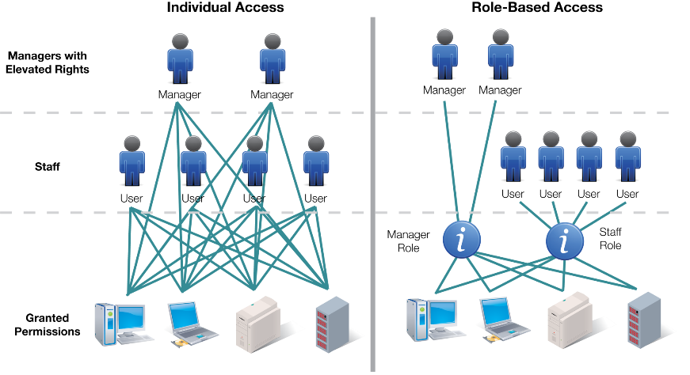
Access Control: Authorization

Slide 9
5.1: Access Control
Human and Organizational Controls
  People and organizational forces may circumvent access protections

Slide 10
5.1: Military and National Security Organization Access Controls
Mandatory and Discretionary Access Control
  Mandatory access control (MAC)
    No departmental or personal ability to alter access control rules set by higher authorities
  Discretionary access control (DAC)
    Departmental or personal ability to alter access control rules set by higher authorities
  MAC gives stronger security but is very difficult to implement

Slide 11
5.1: Military and National Security Organization Access Controls
Multilevel Security
Data Classification reflects the criticality and sensitivity of the information. When data become more important it needs stronger controls.
  Resources are rated by security level
    Public
    Sensitive but unclassified
    Confidential
    Secret
    Top secret
  People are given the same clearance level

Slide 12
5.2: ISO/IEC 27002:2005 Physical and Environmental Security
ISO/IEC 27002’s Security Clause 9, Physical and Environmental Security
Risk Analysis Must Be Done First
ISO/IEC 9.1: Secure Areas
  Securing the building’s physical perimeter (e.g., single point of entry, emergency exits, etc.)
  Implementing physical entry controls
    Access should be justified, authorized, logged, and monitored

Slide 13
5.2: ISO/IEC 27002:2005 Physical and Environmental Security
ISO/IEC 9.1: Secure Areas
  Securing public access, delivery, and loading areas
  Securing offices, rooms, and facilities
  Protecting against external and environmental threats
  Creating rules for working in secure areas
    Limit unsupervised work, forbid data recording devices, etc.

Slide 14
5.2: ISO/IEC 27002:2005 Physical and Environmental Security
9.2 Equipment Security
  Equipment siting and protection
    Siting means locating or placing
  Supporting utilities (e.g., electricity, water, HVAC)
    Uninterruptible power supplies, electrical generators
    Frequent testing

Slide 15
5.2: ISO/IEC 27002:2005 Physical and Environmental Security
9.2 Equipment Security
  Cabling security (e.g., conduits, underground wiring, etc.)
  Security during offsite equipment maintenance
    Permission for taking offsite
    Removal of sensitive information

Slide 16
5.2: ISO/IEC 27002:2005 Physical and Environmental Security
9.2 Equipment Security
  Security of equipment off-premises
    Constant attendance except when locked securely
    Insurance
  Secure disposal or reuse of equipment
    Removal of all sensitive information
  Rules for the removal of property

Slide 17
5.2: Other Physical Security Issues
Terrorism
  Building set back from street
  Armed guards
  Bullet-proof glass
Piggybacking
  Following an authorized user through a door
  Also called tailgating
  Psychologically difficult to prevent
  Piggybacking is worth the effort to prevent

Slide 18
5.2: Other Physical Security Issues
Monitoring Equipment
  CCTV
  Tapes wear out
  High-resolution cameras are expensive and consume a great deal of disk space
  Low-resolution cameras may be insufficient for recognition needs
  To reduce storage, use motion sensing

Slide 19
5.2: Other Physical Security Issues
Dumpster^{[TM]} Diving
  Protect building trash bins that may contain sensitive information
  Maintain trash inside the corporate premises and monitor until removed
Desktop PC Security
  Locks that connect the computer to an immovable object
  Login screens with strong passwords

Slide 20
5.3: Server Password
Challenges
  Reusable Passwords
  Password-Cracking Programs
  Lost passwords

Slide 21
Reusable Passwords
A password that is used multiple times
Almost all passwords are reusable passwords
A one-time password is used only once

Slide 22
5.3: Password Policies
Some approaches
  Strength test and strength policies
  Password duration
  Disabling passwords
  Password management programs

Slide 23
5.3: Password Policies
Other Password Policies
  Lost passwords (password resets)
    Opportunities for social engineering attacks
    Automated password resets use secret questions (i.e., Where were you born?)
      Many can be guessed with a little research, rendering passwords useless
      Some questions may violate security policies

Slide 24
5.5: Biometric Authentication
Authentication based on:
  biological (bio)
  measurements (metrics)
Based on something you:
  Are (e.g., your fingerprint etc.)
  Do (e.g., write, type, and so forth)

Slide 25
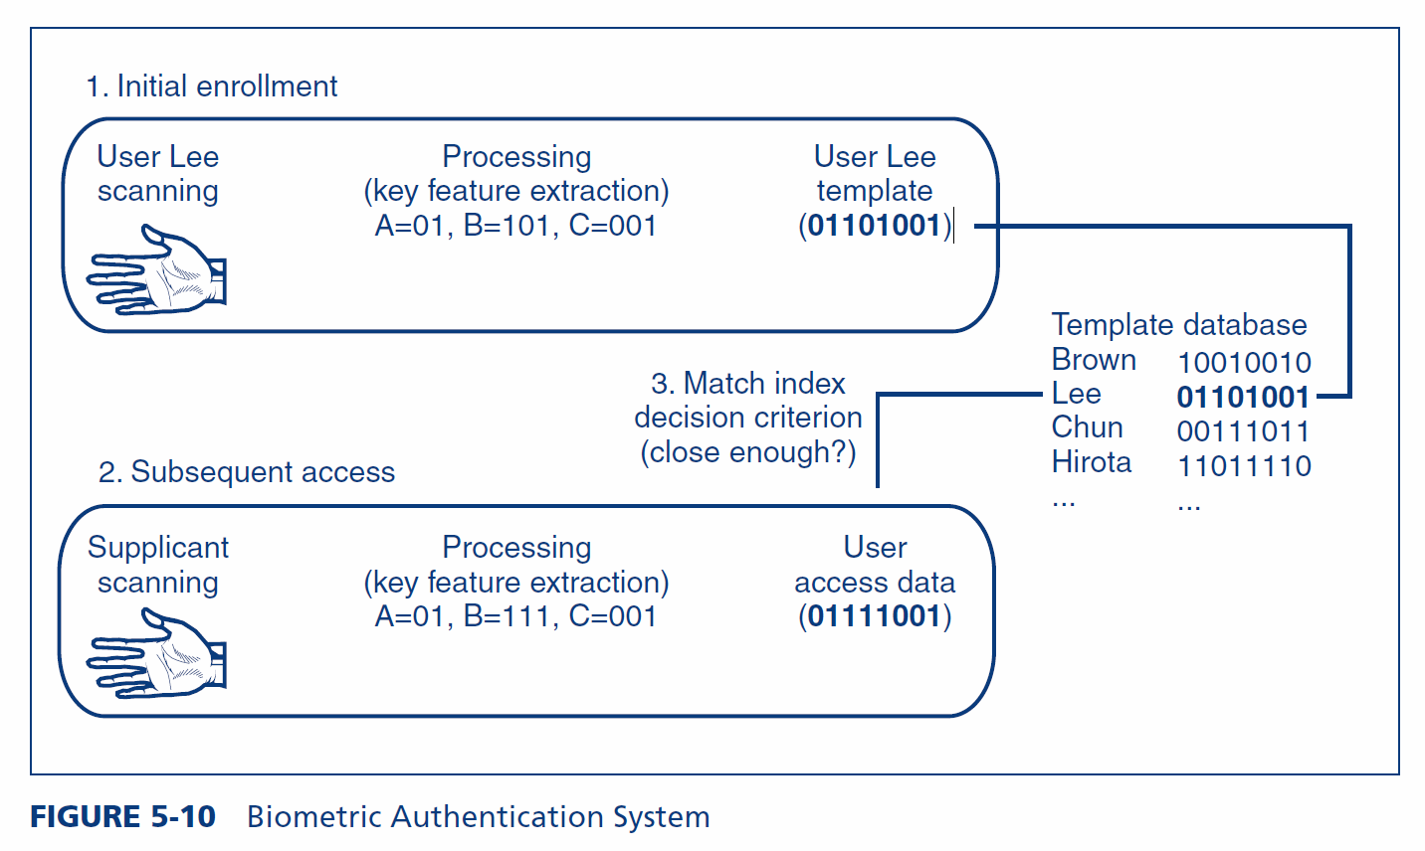
5.5: Biometric Authentication System

Slide 26
5.5: Biometric Authentication
Key features never exactly the template
Needs configurable decision criteria for deciding how close a match is required
  Overly exact match will cause many false rejections
  Too loose a match will cause more false acceptances

Slide 27
5.5: Biometric Errors and Deception
False Acceptance Rates (FARs)
  Percentage of people who are identified or verified as matched to a template but should not be
False Rejection Rates (FRRs)
  Percentage of people who should be identified or verified as matches to a template but are not

Slide 28
5.5: Biometric Errors and Deception
Base Rate Fallacy
  Read the Wikipedia page, we will have an activity during the class.

Slide 29
Base Rate Fallacy
False Acceptance Rate 2%
False Rejection Rate 10%
99% of the time, legitimate users are trying to access
What is the probability of the person being an intruder if they are rejected?
What is the probability of the person being a legitimate user if they are accepted?

Slide 30
5.5: Biometric Verification, Identification, and Watch Lists
Verification or Authentication
  Supplicant claims to be a particular person
  Compare access data to a single template (the claimed identity)
Identification
  Supplicant does not state his or her identity
  System must compare supplicant data to all templates to find the correct template

Slide 31
5.5: Biometric Errors and Deception
Deception
  Many biometric methods are highly vulnerable to deception

Slide 32
Biometric Deception
Deception: when subject is trying to fool the system
    Hide face from face recognition cameras
    Impersonate someone by using a gelatin finger
Errors: are when subject is not trying to fool the system

Slide 33
5.5: Biometric Errors and Deception
Which is Worse?
  It depends on the situation
Situation | False acceptance | False rejection
Identification for computer access | Security Violation | Inconvenience
Verification for computer access | Security Violation | Inconvenience
Watch list for door access | Security Violation | Inconvenience
Watch list for terrorists | Inconvenience | Security Violation

Slide 34
5.5: Biometric Errors and Deception
Vendor Claims for FARs and FRRs
  Tend to be exaggerated through tests under ideal conditions
Failure to Enroll (FTE)
  Subject cannot enroll in system
  E.g., poor fingerprints due to construction work, clerical work, age, etc.

Slide 35
5.5: Biometric Methods
Fingerprint
Iris
Face
Voice
Keystroke
Gait

Slide 36
5.5: Biometric Methods
Fingerprint Recognition
  Simple, inexpensive, well proven
  Most biometrics today are fingerprint recognition
  Often can be defeated with latent fingerprints on glass copied to gelatin fingers
  Fingerprint recognition can take the place of reusable passwords for low-risk applications

Slide 37
5.5: Biometric Methods
  Fingerprint scanners:
    should only be used when the threat of deception is very low
    are better than passwords because there is nothing to forget
    are good for convenience rather than security

Slide 38
5.5: Biometric Methods
Iris Recognition
  Pattern in colored part of eye
  Uses a camera (no light is shined into eye, as in Hollywood movies)
  Very low FARs
  Very expensive

Slide 39
5.5: Biometric Methods
Face Recognition
  Surreptitious identification is possible (in airports, etc.)
  Surreptitious means without the subject’s knowledge
  High error rates, even without deception

Slide 40
5.7: Principle of Least Permissions
Authentication: Proof of identity
Authorization: The assignment of permissions (specific authorizations) to individuals or roles
Just because you are authenticated does not mean that you have the authorization to do everything

Slide 41
5.7: Principle of Least Permissions
Principle of Least Permissions
  Initially give people only the permissions a person absolutely needs to do his or her job
If assignment is too:
  Narrow, the system fails safely, and additional permissions may be given
  Broad, the does not fail safely. While permission can be take away, the action could be subject to error.

Slide 42
5.8: Auditing
Auditing
  Authentication: Who a person is
  Authorization: What a person may do with a resource
  Auditing: What the person actually did

Slide 43
5.8: Auditing
Authentication: Who a person is
Authorization: What a person may do with a resource
Auditing: What the person actually did
Logging
  Events on a server, logins, failed login attempts etc.

Slide 44
5.8: Auditing
Log Reading
  Regular log reading is crucial or the log becomes a useless write-only memory
  Periodic external audits of log file entries and reading practices
  Automatic alerts for strong threats

Slide 45
5.10: Identity Management
Definition
  Identity management is the centralized policy-based management of all information required for access to corporate systems by a person, machine, program, or other resource.

Slide 46
5.10: Identity Management
Benefits of Identity Management
  Reduction in the redundant work needed to manage identity information
  Consistency in information
  Rapid changes
  Central auditing
  Single sign-on
  Increasingly required to meet compliance requirements
  At least reduced sign-on when SSO is impossible

Slide 47
5.10: Identity Management
Identity
  The set of attributes about a person or nonhuman resource that must be revealed in a particular context
  Principle of minimum identity data: only reveal the information necessary in a particular context

Slide 48
5.10: Identity Management
Identity Management
  Initial credential checking
  Defining identities (pieces of information to be divulged)
  Managing trust relationships
  Provisioning, reprovisioning if changes, and deprovisioning

Slide 49
The End

Slide 50

Copy Right Statement
All rights reserved. No part of this publication may be reproduced, stored in a retrieval system, or transmitted, in any form or by any means, electronic, mechanical, photocopying, recording, or otherwise, without the prior written permission of the publisher. Printed in the United States of America.
Copyright © 2015 Pearson Education, Inc.

